Slide 1

SMART INDIA HACKATHON 2026
TITLE PAGE
Problem Statement ID –26217
Problem Statement Title-Student Innovation-Innovative ideas that help manage and generate renewable /sustainable sources more efficiently
Theme-Clean & Green Technology
PS Category-Hardware
Team ID-179046
Team Name-BioBreath

Slide 2
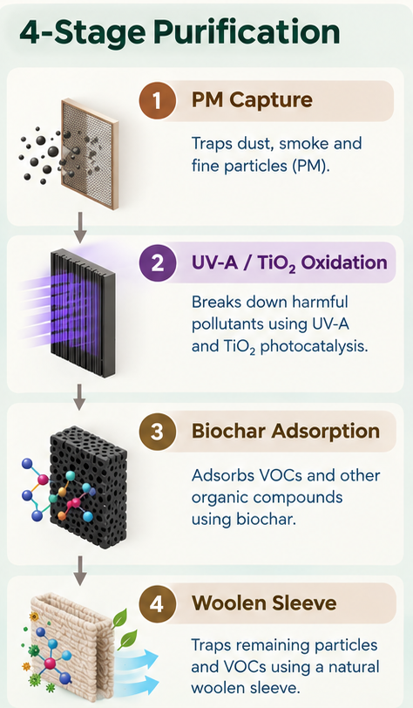
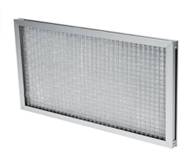
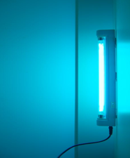
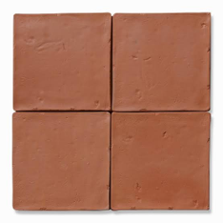
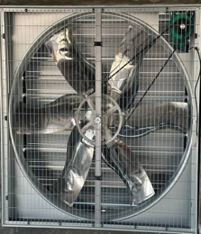
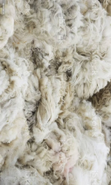

IDEA TITLE
BioBreath
Proposed solution:
VayuJeeva BioWall is a smart, source-capture air-purification module that intercepts indoor pollutants at their origin—such as cooking, incense, and cleaning—before they spread throughout the room.
Problem & Resolution
VayuJeeva addresses indoor pollution spikes, slow passive diffusion, filter saturation, and lack of performance visibility by capturing pollutants directly at their source, treating them through multi-stage filtration, supporting biochar regeneration, and providing real-time IoT monitoring.
Innovation & Uniqueness
Source-capture + 4-stage purification combines PM filtration, UV-A/TiO₂ oxidation, biochar adsorption, and wool-based biological treatment.
Bio-regenerating filtration uses microbial activity to support VOC degradation and extend biochar functionality.
Sustainable modular design combines fired terracotta housing with replaceable cartridges.
Smart IoT control uses sensors and ESP32 to monitor air quality and adapt system operation.

Slide 3
TECHNICAL APPROACH
BioBreath
Source-Capture Hood + 3D Printed Duct
Washable PM Prefilter
Removes dust & particles
Biochar Buffer Media
Adsorbs VOCs & PM
Living Wool Sleeve Microbial VOC Degradation
UV-A + TiO₂ PCO Chamber Oxidizes Pollutants
POLLUTED AIR
Calibrated Testing Active vs Passive Performance Cycles
Adaptive Optimization Duty Cycle UV Moisture CADR/Watt Data Logging
ESP32 + Sensors PM • VOC • T/RH • ΔP
Variable-Speed Blower Controlled Airflow
CLEAN AIR
TECHNOLOGIES USED:
Source Capture + UV-A/TiO₂ PCO + Biochar Adsorption + Wool Biofiltration + IoT Sensing + Adaptive Airflow + Terracotta Modular Design.
YouTube Link : https://youtu.be/Gjkb1LPXgA8
GitHub Link : https://github.com/saniyabeig789-cyber/VayuJeeva-SIH2026

Slide 4
FEASIBILITY AND VIABILITY
BioBreath
Analysis of Feasibility
Technical & Financial: Low-cost prototype targeted at ₹2,000–₹2,500 using modular terracotta, ESP32, and living biochar media.
Market Demand: High demand for localized, affordable indoor source-capture air treatment over costly passive purifiers.
Operational Simplicity: Easy assembly relying on standardized electronic components and replaceable living cartridges.
Potential Challenges and Risks
Technical Risks: Living microbial cartridges drying out or failing under extreme ambient conditions.
Financial & Market: Sensor price fluctuations impacting build cost, plus consumer skepticism of biological filters.
Operational Limits: Supply chain dependencies for specialized parts like UV-A drivers and ESP32 microcontrollers.
Strategies for Overcoming Challenges
Automated Safeguards: Implement automated moisture backup and adaptive fan duty cycles to protect living microbes.
Bulk Sourcing & Proof: Secure components in bulk for the ₹2,000 target and use falsifiable test data to prove performance.
Smart Monitoring: Integrate sensor-driven self-calibration and automated dashboard alerts for easy maintenance.

Slide 5
IMPACT AND BENEFITS
BioBreath
IMPACTS
Healthier indoor air by reducing exposure to PM and VOC pollutants.
Affordable pollution control for homes, classrooms, clinics, and small workplaces.
Lower maintenance through modular, replaceable filtration cartridges.
Real-time awareness through IoT-based air-quality monitoring.
Sustainable adoption using terracotta and bio-based filtration materials.
BENEFITS
Social: Promotes healthier indoor environments and improves awareness of indoor air quality.
Economic: Potentially lowers maintenance and replacement costs through modular, replaceable cartridges.
Environmental: Uses terracotta and bio-based materials, supporting a lower-waste purification approach.
Technological: Integrates biotechnology, IoT sensing, smart airflow control, and photocatalysis in one system.
Scalability: Can be adapted for homes, classrooms, clinics, and small workplace

Slide 6
RESEARCH AND REFERENCES
BioBreath
WHO – Household Air Pollution and Health
Supports the importance of reducing indoor/household air-pollution exposure and its health impacts.
WHO – Household Air Pollution and Health
U.S. EPA – Improving Indoor Air Quality
Supports source control, ventilation and filtration as major approaches to improving indoor air quality. This directly supports VayuJeeva's source-capture concept.
EPA – Improving Indoor Air Quality
U.S. EPA – What is Indoor Air Quality?
Useful for supporting the importance of indoor air quality and the role of source control and air cleaning.
EPA – Indoor Air Quality Factsheet
TiO₂ Photocatalytic Oxidation Review – Building and Environment (2024)
Supports the scientific basis of TiO₂-based photocatalytic oxidation for indoor VOC removal, while also highlighting the need to evaluate by-products and performance limitations.
TiO₂-based PCO for Indoor Air VOC Removal – ScienceDirect

